Slide 1
Rules
Please mute your microphones
Please do not interrupt during the lessons
Write your questions in a chat or raise your hand – I will answer to all your questions in the end of each lesson during 10-15 min Q&A session
Thank you ☺

Slide 2
Getting started with big data
Introductory lecture
Tetiana Yukhymenko
Monetary Policy and Economic Analysis Department
National Bank of Ukraine
February 2021, Kyiv

Slide 3
What is big data and why is it important for macroeconomic research?

Slide 4
Big data usage

Slide 5
Big data refers to data that is large, fast or complex that it’s difficult or impossible to process using traditional methods
Characteristics
Volume
Variety
Velocity
Veracity
Value
Viability

Slide 6
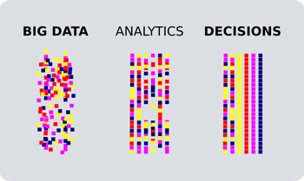
Big data benefits
New products and services
Smarter decisions
Real-time data
Cost efficiency
Time reductions

Slide 7
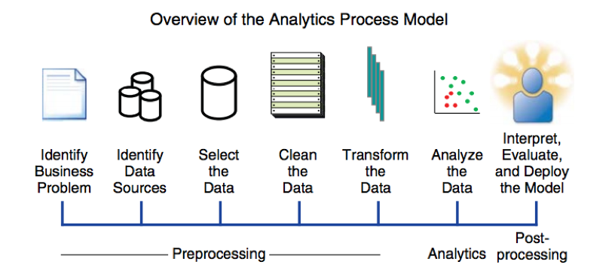
Big data processing

Slide 8
Big data analysis techniques
Machine learning
Data mining
Statistics
Data fusion and data integration
Artificial intelligence
Visualization
A/B testing
Natural language processing
Web-Scraping
Optimization

Slide 9
Big Data Problems
Human resources
Lack of understanding
Data management
Complex systems for managing data
Low quality and inaccurate data
Other
High cost of data solutions, i.e. due to scaling data
Lack of skilled workers
Using data for meaning
Too many choices
Processing large data sets
Constantly changing data
Mixed frequency and time aggregation
Missing observations
Security issues
Accessibility
Pace of technology

Slide 10
Big data and macroeconomics
Big data has created opportunities for economists and policymakers to learn about economic systems and choices with a higher degree of precision
Pros
Complex data are now available, and the ability to link many data sets together.
Powerful new analytic techniques derived from machine learning are increasingly part of the mainstream econometric toolbox.
Cons
Predictions based on Big Data may have privacy concerns.
Machine learning methods are computationally intensive, may not have unique solutions, and may require a high degree of fine tuning for optimal performance.
Big Data allows for better prediction of economic phenomena and improves causal inference.
Machine learning techniques allow researchers to create simple models that describe very large, complex data sets.
Machine learning methods and Big Data also allow for the complex modeling of relationships that predict well beyond the sample.
Big Data analysis requires investments in technology and human skill.
Big Data may suffer from selection bias depending on how and by whom data are being generated.
Access to these data may involve partnering with firms who limit researcher freedom.
Source: https://wol.iza.org/articles/big-data-in-economics/long

Slide 11
Big data application in macroeconomics
Current trends analysis
Nowcasting
Forecasting
Causal inference

Slide 12
Where does big data come from?

Slide 13
Big data forms
Past: spreadsheets and databases
Present: web-sites, emails, PDFs, photos, videos, audios, SM posts etc.

Slide 14
Big data sources
Social media
Cloud platforms
Web
IoT
Databases
Comments, likes
Public profiles
Pictures, video, audio etc.
Data stored and sourced on public or private clouds
Public web
Open API
Dark web
Machine-generated content
Data generated from the sensors
Traditional and modern databases

Slide 15
Types of data
Structured
Predefined and formatted to a set structure before being placed in data storage
Easily used by machine learning algorithms
Unstructured
Stored in its native format and not processed until it is used
Freedom of the native format
Easily used by users
Increased access to more tools
Faster accumulation rates
Limited usage
Requires data science expertise

Slide 16
How to work with big data?

Slide 17








User friendly Analytics Software

Slide 18



Big Data Programming Languages

Slide 19
Python
Python has rich ecosystem of high-quality libraries
Python is universal
Python is relatively easy to learn, due to the natural language-like syntax
69% of ML developers and data scientists use Python
Python is stable and predictable
>5 million Python users today
Free and open-source

Slide 20




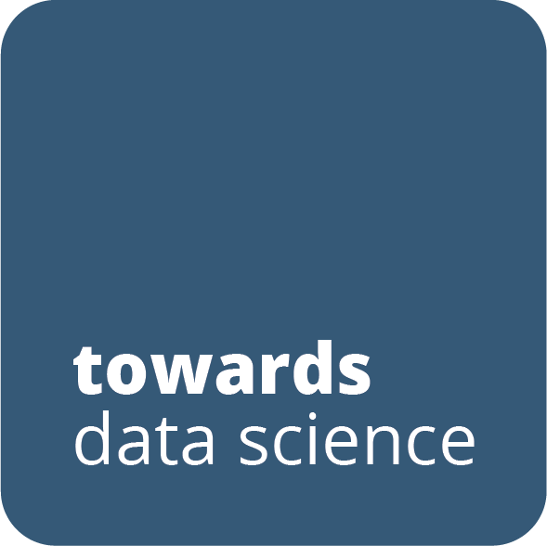


Where to learn Python?

Slide 21
How to install Python?
Step 1: Select Version of Python to Install
Step 2: Download Python Executable Installer
Step 3: Run Executable Installer
Step 4: Verify Pip Was Installed (in Command Line/Terminal type pip v-)
Step 5: Add Python Path to Environment Variables (Optional)
Step 6: Install virtualnv (Optional)

Slide 22



Python IDE (integrated development environment)

Slide 23
Python modules for big data
Beautiful Soup is a Python package for parsing HTML and XML documents (including having malformed markup, i.e. non-closed tags, so named after tag soup). It creates a parse tree for parsed pages that can be used to extract data from HTML, which is useful for web scraping.
NumPy is a library for the Python programming language, adding support for large, multi-dimensional arrays and matrices, along with a large collection of high-level mathematical functions to operate on these arrays.
pandas is a software library written for the Python programming language for data manipulation and analysis. In particular, it offers data structures and operations for manipulating numerical tables and time series.
Matplotlib is a plotting library for the Python programming language and its numerical mathematics extension NumPy.
Scikit-learn is a free software machine learning library for the Python programming language. It features various classification, regression and clustering algorithms, and is designed to interoperate with the Python numerical and scientific libraries NumPy and SciPy.
Statsmodels is a Python package that allows users to explore data, estimate statistical models, and perform statistical tests. An extensive list of descriptive statistics, statistical tests, plotting functions, and result statistics are available for different types of data and each estimator.

Slide 24
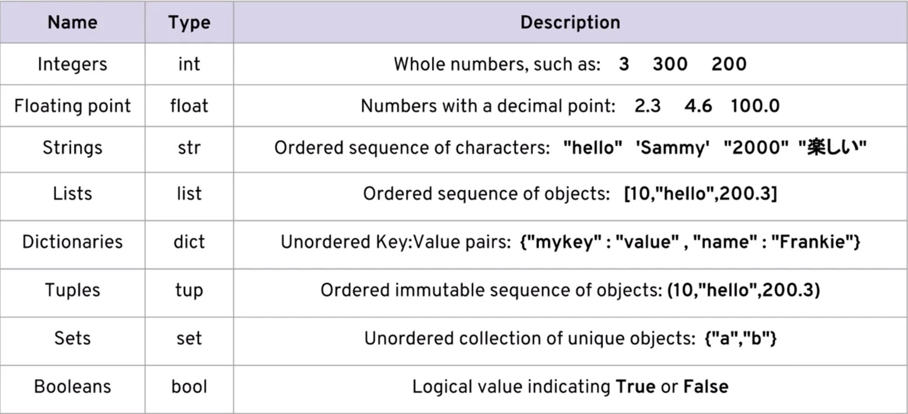
Python data types

Slide 25
Big data at National bank of Ukraine

Slide 26
CPI Nowcast at NBU
Retailer selection
Creation of Python script based on HTML-page
Fix problem
Find problem
No
Launching script on daily basis
Data converted into CSV-file
Yes
Add data to database
Initial analysis of data
Create time series
New SKU found
Update dictionary
CPI Nowcast

Slide 27
Data characteristics
Average daily quantity of price data collected
CPI basket coverage by WS, %
Kyiv
Odesa
Dnipro
Kharkiv
Lviv
Source: online supermarkets, NBU staff estimates.
Source: SSSU, NBU staff estimates.

Slide 28
Geographical coverage

Slide 29
CPI-nowcasting: results
Price change for all scraped products *,% mom
Price change for foods,% mom
* 185 products, the official CPI is reduced to the same basket.
Source: SSSU, NBU.
Source: SSSU, NBU.
In general, the trend of price changes in the consumer set corresponds to the data collected using web scraping
Deviations can be explained by different geographical and product coverage, as well as the business model of outlets
With the data collected from online sources and with the use of other modeling tools, the NBU can produce short term inflation assessments nearly two weeks prior to the publication of the official data by the SSSU and use the projections for in-depth analyses and monetary policy implementation

